Slide 1


Course Name
object oriented analysis and design
CSC 2210
(Undergraduate)
Software engineering (Undergraduate)
Chapter 2
use case diagram
MD.AL-AMIN
Assistant professor, CS, AIUB

Slide 2
Usage of Use case diagram?
Chapter 2: Use Case Diagram
Md.Al-Amin
MMH
S.2
Use case diagrams are used to visualize, specify, construct, and document the (intended) behavior of the system, during requirements capture and analysis.
Provide a way for developers, domain experts, and end-users to Communicate.
Serve as basis for testing.
Use case diagrams contain use cases, actors, and their relationships.

Slide 3

USE Case
Chapter 2: Use Case Diagram
Md.Al-Amin
MMH
S.3
Use cases specify desired behavior.
A use case is a description of a set of sequences of actions, including variants (alternatives),
a system performs to yield an observable result of value to an actor.
  The names of use cases are always written in the form of a verb followed by an object.
Each sequence represent an interaction of actors with the system.
Describing the flow of events within the use case.
Can be done in natural language, formal language or pseudo-code.
Includes:
  How and when the use case starts and ends;
  When the use case interacts with actors and what objects are exchanged;
  The basic flow and alternative flows of the behavior.

Slide 4
actor
Chapter 2: Use Case Diagram
Md.Al-Amin
MMH
S.4
An actor represents a set of roles that users of use case play when interacting
with these use cases.
Actors can be human or automated systems.
Actors are entities
  which require help from the system to perform their task, or
  are needed to execute the system’s functions.
Actors are not part of the system.
A system can be an Actor of other systems
Actor

Slide 5
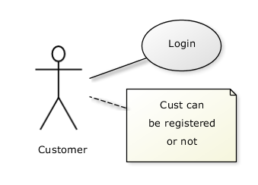
Use cases and actor
Chapter 2: Use Case Diagram
Md.Al-Amin
MMH
S.5
From the perspective of a given actor, a use case does something that is of value to the actor, such as calculate a result or change the state of an object.
The Actors define the environments in which the system lives
Actors may be connected to use cases by associations, indicating that the actor and the use case communicate with one another using messages.
updating
grades
faculty

Slide 6
Example of Use cases diagram
Chapter 2: Use Case Diagram
Md.Al-Amin
MMH
S.6
University Management System
Login
Registration of Course
Faculty
Student
Upload
Grade

Slide 7
Relationships between Use cases
Chapter 2: Use Case Diagram
Md.Al-Amin
MMH
S.7
Include - use cases that are included as parts of other use. Enable to factor common behavior
The base use case explicitly incorporates the behavior of another use case at a location
specified in the base.
The included use case never stands alone. It only occurs as a part of some larger base
that includes it. The original use case is not complete without the included one
base
<<include>>
included

Slide 8
Relationships between Use cases
Chapter 2: Use Case Diagram
Md.Al-Amin
MMH
S.8
Enables to avoid describing the same flow of events several times by putting the common behavior in a use case of its own.
updating
grades
<<include>>
verifying
Id and password
<<include>>
registration

Slide 9
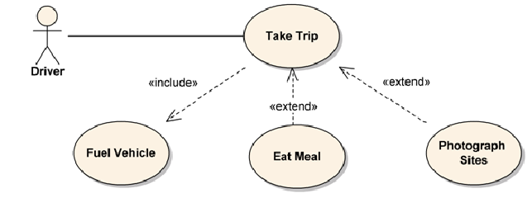
Relationships between Use cases
Chapter 2: Use Case Diagram
Md.Al-Amin
MMH
S.9
Extend – a part of a use case that is optional system behavior
The base use case implicitly incorporates the behavior of another use case at certain points called extension points.
The base use case may stand alone, but under certain conditions its behavior may be extended by
the behavior of another use case.
Enables to model optional behavior or branching under conditions.
Vacation
<<extend>>
base
extending

Slide 10
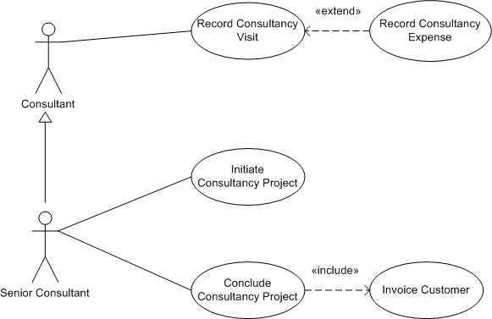
Relationships between Use cases
Chapter 2: Use Case Diagram
Md.Al-Amin
S.10
MMH
Generalization - A generalization relationship means that a child use case inherits the behavior and meaning of the parent use case. The child may add or override the behavior of the parent.

Slide 11
Use cases description
Chapter 2: Use Case Diagram
Md.Al-Amin
S.11
MMH
  Title or Reference Name - meaningful name of the UC
  Author/Date - the author and creation date
  Modification/Date - last modification and its date
  Purpose - specifies the goal to be achieved
  Overview - short description of the processes
  Cross References - requirements references
  Actors - agents participating
  Pre-Conditions - must be true to allow execution
  Post Conditions - will be set when completes normally
  Normal flow of events - regular flow of activities
  Alternative flow of events - other flow of activities
  Exceptional flow of events - unusual situations
  Implementation issues - foreseen implementation problems

Slide 12
Use cases example – atm money withdraw
Chapter 2: Use Case Diagram
Md.Al-Amin
S.12
MMH
Use case Title: UC-1
Use Case: Withdraw Money
Author: Jack Lonagon
Created Date: 1-OCT-2015
Modification Date: 20-Apr-2017
Purpose: To withdraw some cash from user’s bank account
Overview: The use case starts when the customer inserts his credit card into the system.
The system requests the user PIN. The system validates the PIN. If the validation succeeded,
the customer can choose the withdraw operation else alternative 1 – validation failure is executed.
The customer enters the amount of cash to withdraw. The system checks the amount of cash
in the user account, its credit limit. If the withdraw amount in the range between the current
amount + credit limit, the system dispense the cash and prints a withdraw receipt,
else alternative 2 – amount exceeded is executed.
Cross References: UC-3

Slide 13
Use cases example – atm money withdraw
Chapter 2: Use Case Diagram
Md.Al-Amin
S.13
MMH
Actors: Customer
Pre-Condition:
  The ATM must be in a state ready to accept transactions
  The ATM must have at least some cash on hand that it can dispense
  The ATM must have enough paper to print a receipt for at least one transaction
Post Condition:
  The current amount of cash in the user account is the amount before the withdraw minus the withdraw amount
  A receipt was printed on the withdraw amount
  The withdraw transaction was audit in the System log file

Slide 14
Use cases example – atm money withdraw
Chapter 2: Use Case Diagram
Md.Al-Amin
S.14
MMH
Typical Course of events:
Actor Actions | System Actions
1. Begins when a Customer arrives at ATM
2. Customer inserts a Credit card into ATM & PIN | 3. System verifies the customer ID and PIN
5. Customer chooses “Withdraw” operation | 4. System asks for an operation type
7. Customer enters the cash amount | 6. System asks for the withdraw amount
 | 8. System checks if withdraw amount is legal (50k per day)
 | 9. System dispenses the cash
 | 10. System deduces the withdraw amount from account balance and set new balance
 | 11. System prints a receipt
13. Customer takes the cash and the receipt | 12. System ejects the cash card

Slide 15
Use cases example – atm money withdraw
Chapter 2: Use Case Diagram
Md.Al-Amin
S.15
MMH
Alternative flow of events:
  Step 3: Customer authorization failed. Display an error message, cancel the transaction and eject the card. Some other thing may happen for example go to step 2 try login again for maximum 3 times and after that the failed login attempt will seize and inform related authority of any suspicious activity in the ATM machine.
  Step 8: Customer has insufficient funds in its account. Display an error message and go to step 6.
  Step 8: Customer exceeds its legal amount. Display an error message and go to step 4.
Exceptional flow of events:
  Power failure in the process of the transaction before step 9, cancel the transaction and eject the card

Slide 16
Identify Use cases
Chapter 2: Use Case Diagram
Md.Al-Amin
S.16
MMH
One method to identify use cases is actor-based:
  - Identify the actors related to a system or organization.
  For each actor, identify the processes they initiate or participate in.
A second method to identify use cases is event-based:
- Identify the external events that a system must respond to.
- Relate the events (cash withdraw) to actors (customer) and use cases (ATM system).
The following questions may be used to help identify the use cases for a system:
  What are the tasks of each actor ?
  Will any actor create, store, change, remove, or read information in the system ?
  What use cases will create, store, change, remove, or read this information ?
  Will any actor need to inform the system about sudden, external changes ?
  Does any actor need to be informed about certain occurrences in the system ?

Slide 17
Case Study 1:
The use case starts when the customer inserts his credit card into the system. The system requests the user PIN. The system validates the PIN. If the validation succeeded, the customer chooses the withdraw operation. The customer enters the amount of cash to withdraw. The system checks the amount of cash in the user account, its credit limit. If the withdraw amount is in the range between the current amount and credit limit, the system dispenses the cash and prints a withdraw receipt and ejects the card.

Slide 18
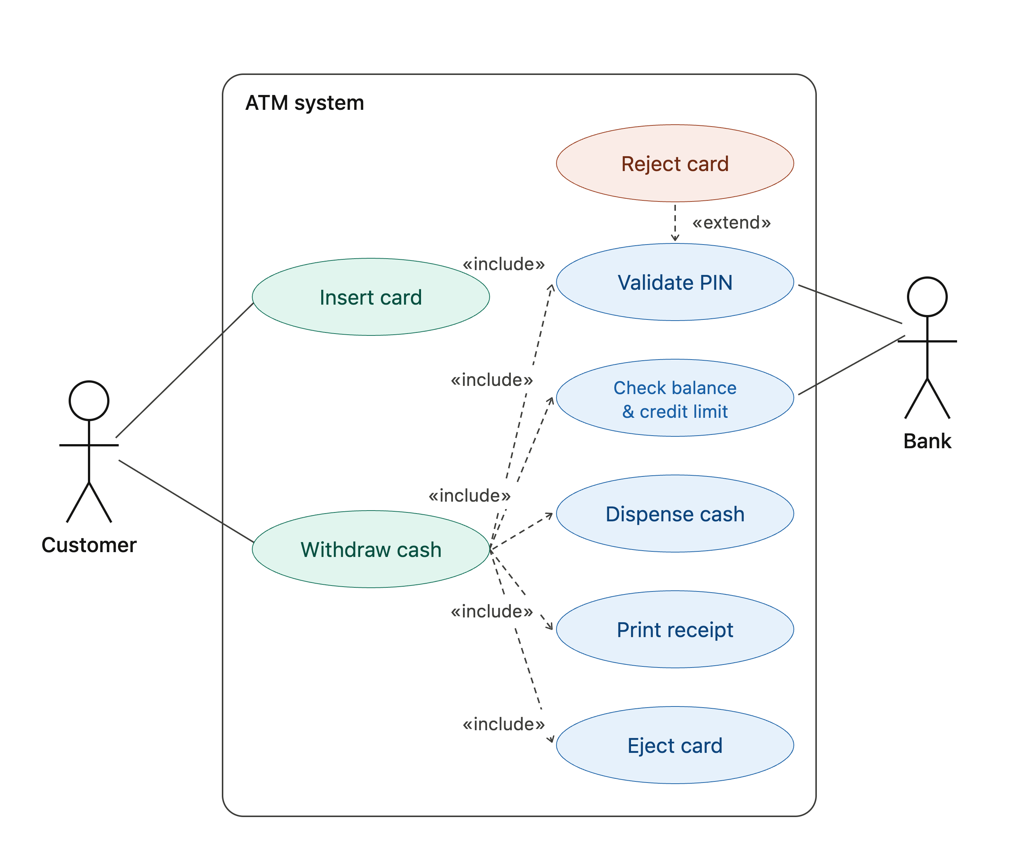

Slide 19
references
Chapter 2: Use Case Diagram
Md.Al-Amin
S.19
MMH
Booch, G., Rumbaugh, J. & Jacobson, I. (2005). The unified modeling language user guide. Pearson Education India.

